Slide 1
Data understanding and preprocessing
Mammographic Masses Dataset
Made by:
Andreas Meeldijk, Lukas van Dee & Abischan Manimaran

Slide 2
Dataset Overview
961 mammographic examinations
Patient demographics (Age) + Imaging features (BI-RADS, Shape, Margin, Density)
Binary Target:
Benign / non-cancerous (0) vs Malignant / cancerous (1)

Slide 3
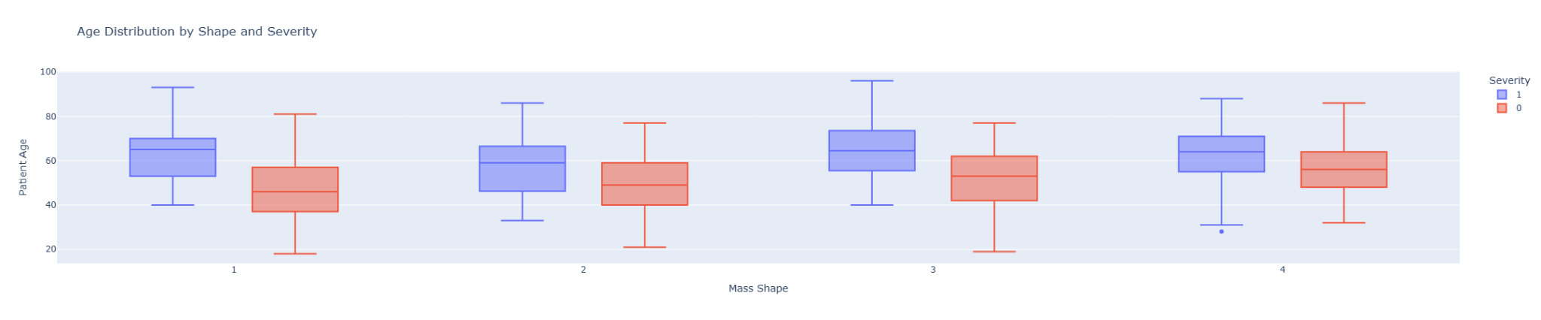
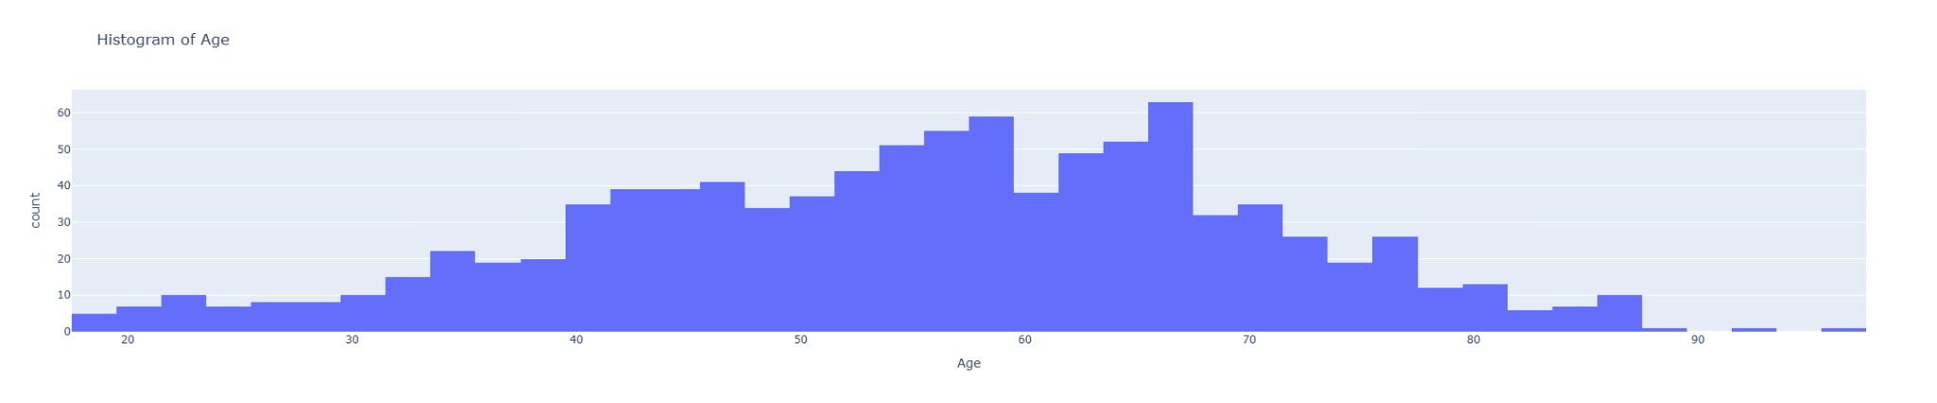
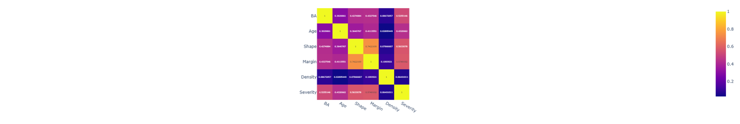

Slide 4
Visualization
Large amount of data points compressed into immediate insights
Exploration:
Discover unknown patterns, outliers, and relationships
Analysis:
Gain deeper insights and confirm/refute hypotheses
Communication:
Effectively show findings to others (stakeholders, clients, colleagues)

Slide 5
Data Quality Issues
Count of null-values per column
BA 2
Age 5
Shape 31
Margin 48
Density 76
Severity 0
Age null-values filled with mean
BA, Shape, Margin, Density null-values dropped (categorical)
Notes:
We chose dropna() over filling categorical missing values because in medical diagnosis, it's better to exclude uncertain cases rather than make assumptions about mammographic characteristics that could affect cancer detection accuracy

Slide 6
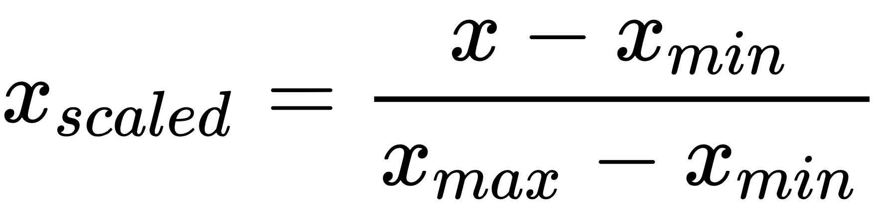
Normalization
Eliminates data redundancy, avoid unnecessary duplication of data.
Features with different scales dominate algorithms
Each feature gets fair consideration in the model
BA, Age, Density because they have different numerical scales (Age: 18-96, BI-RADS: 1-6, Density: 1-4)
Notes:
that would cause machine learning algorithms to give disproportionate weight to Age simply due to its larger numerical range, not its actual importance.

Slide 7
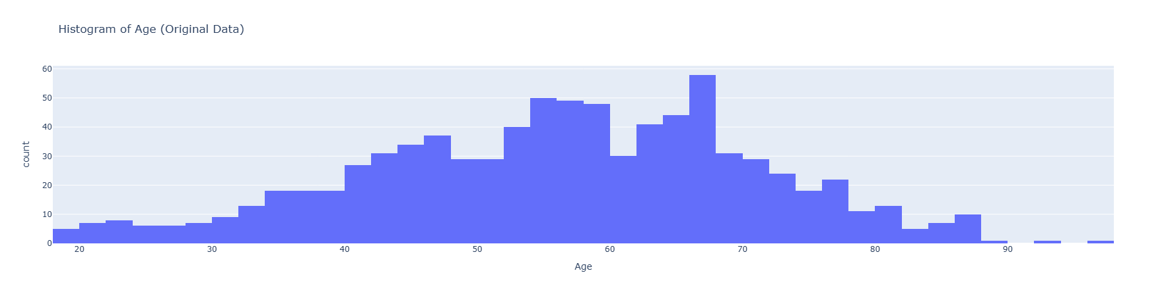
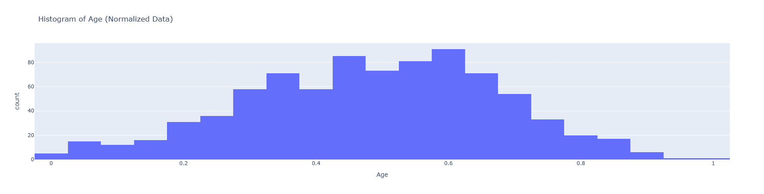

Slide 8
Feature selection
Applied SelectKBest with f_classif scoring to automatically select the top 3 most important features
Used F-statistics to measure how well each feature separates benign vs malignant cases
Set elimination threshold at the 3rd highest F-score

Slide 9
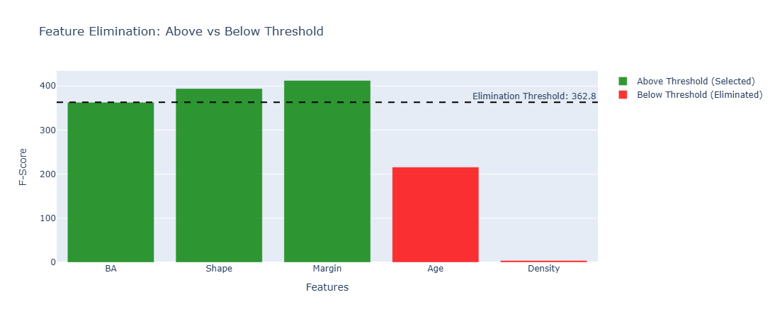
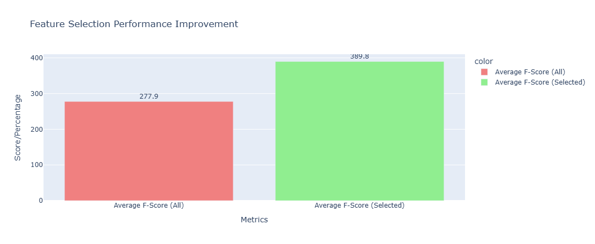
Feature selection

Slide 10
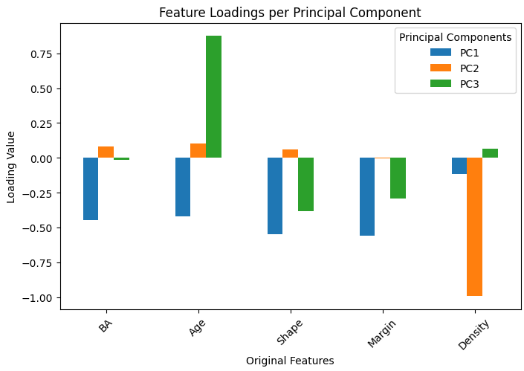
PCA dimensionality
reduction
The loadings tell us what each Principal component represents
We can categorize these components

Slide 11
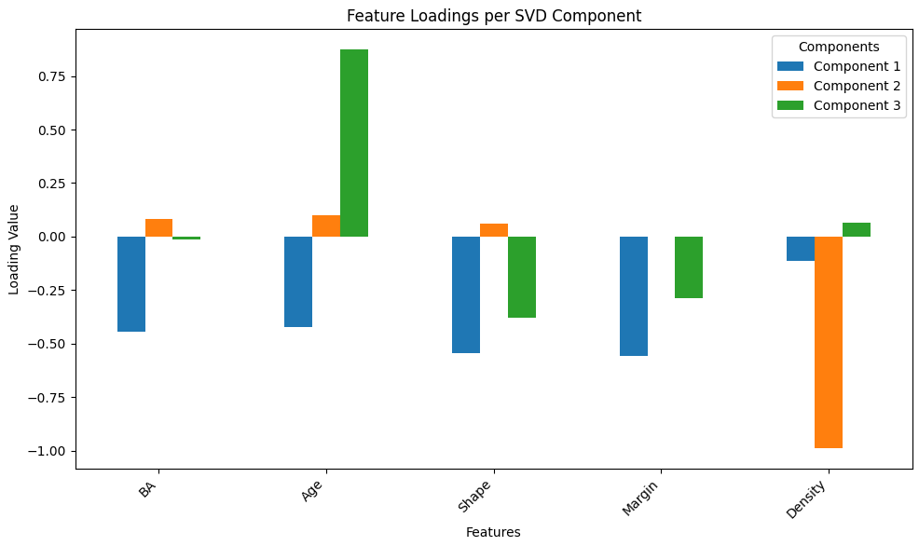
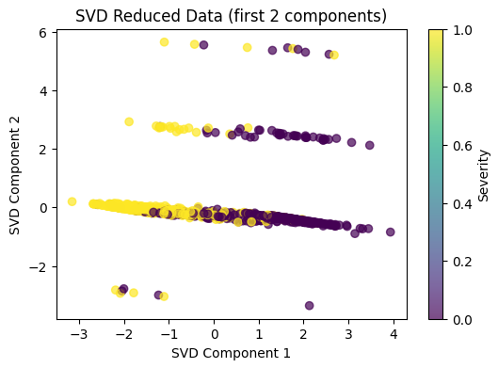
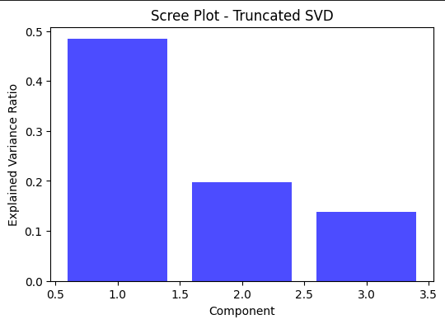
Truncated SVD-algorithm
similar to PCA DR

Slide 12
Conclusions
Similar results with PCA and truncated SVD because of scaled data
Density
Ordinal and nominal data make it difficult to use PCA and truncated SVD
One-hot encoding

Slide 13
Questions / Discussion

